Slide 1
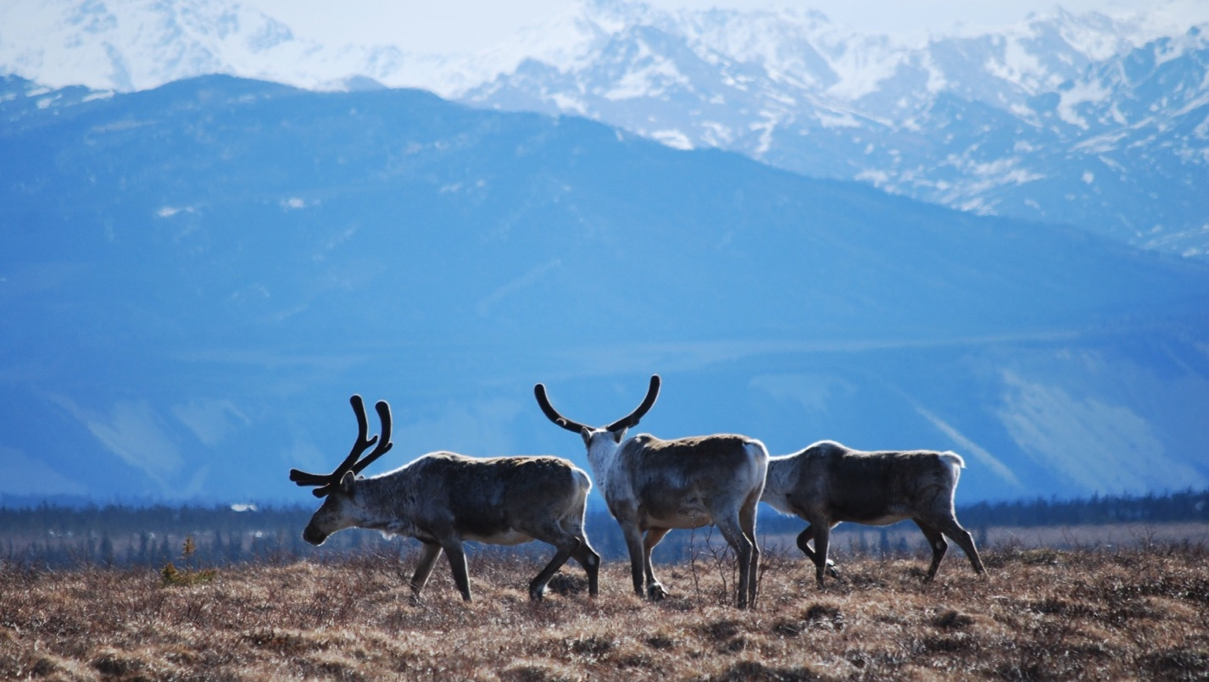
Arctic Boreal Vulnerability Experiment (ABoVE)
2019 ABoVE Airborne Flights
7 July 2019 (DOY 188)
AVIRIS-NG: Seward Peninsula – Noatak
Charles Miller, Deputy Science Lead
Jet Propulsion Laboratory, California Institute of Technology
and the ABoVE Science Team For Hank Margolis, Mike Falkowski, Bruce Tagg, Jack Kaye
NASA HQ
2019

Slide 2
7 July 2019/DOY 188 Seward Peninsula – Noatak
Daily Status:
AVIRIS-NG / Dynamic Aviation B-200 (N53W)
REPORT DATE: 7 July 2019
Current Status of Aircraft: GREEN
Current Status of AVIRIS: GREEN
Current Deployment Location: Fairbanks AK (PAFA)
Crew: S Wilson (PIC), C McCann, M Eastwood, M Helmlinger, J Chapman
Science Planning: A Thorpe
Data Processing: W Olsen-Duvall
Instrument Manager: M Eastwood
Instrument PI: R Green
Science Lead: C Miller

Slide 3
7 July 2019/DOY 188 Seward Peninsula – Noatak
Daily Summary:
Severe clear over the Seward Peninsula and Noatak Delta
NGEE-Arctic team in the field at Seward Peninsula sites obtaining simultaneous ground truth spectra and vegetation data

Slide 4
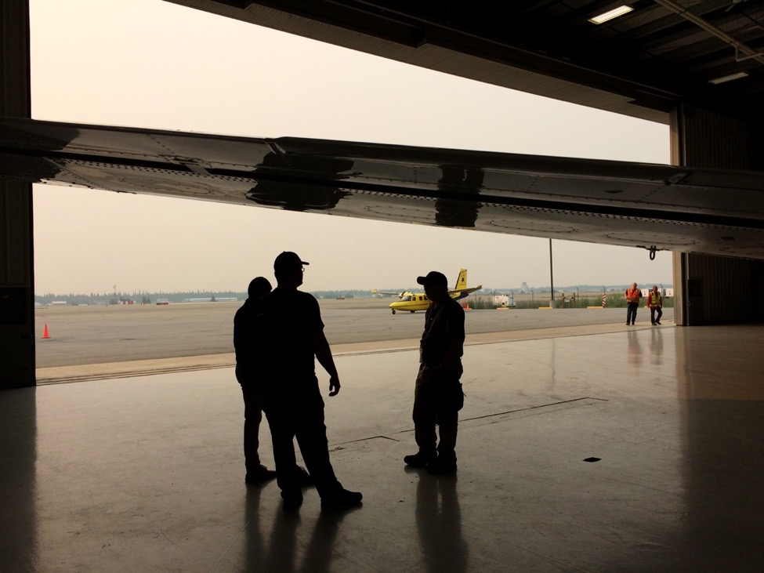
7 July 2019/DOY 188 Seward Peninsula – Noatak
Herschel Island

Slide 5
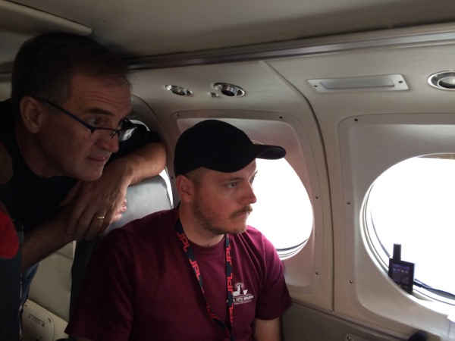
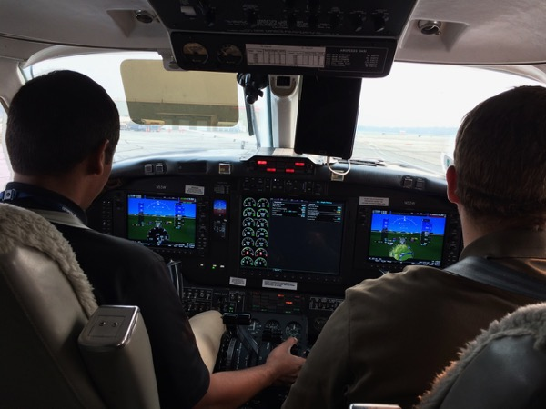
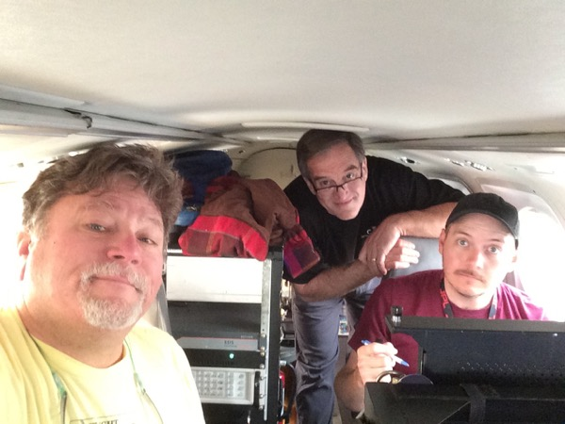
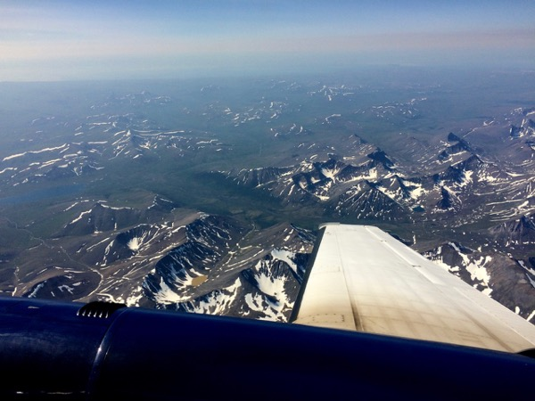
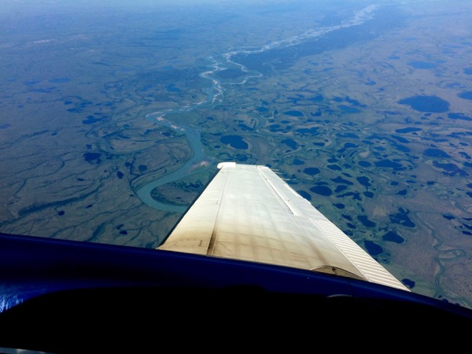
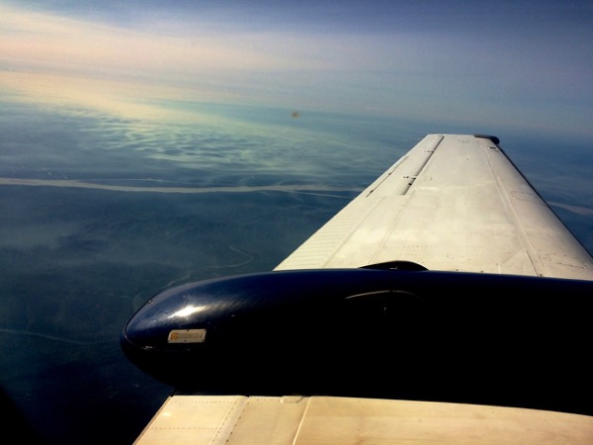
7 July 2019/DOY 188 Seward Peninsula – Noatak

Slide 6
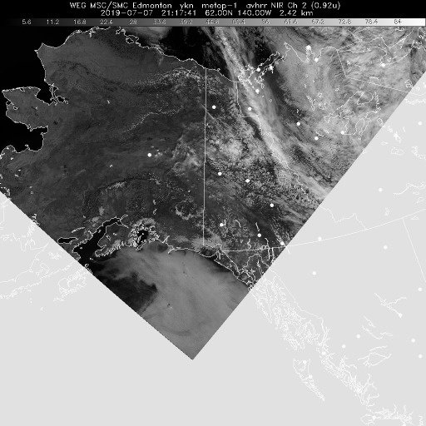
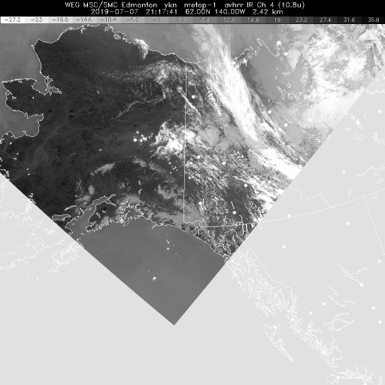
7 July 2019/DOY 188 Seward Peninsula – Noatak
Vis 2117Z
IR 2117Z
Notes:
No clouds or fog at all

Slide 7
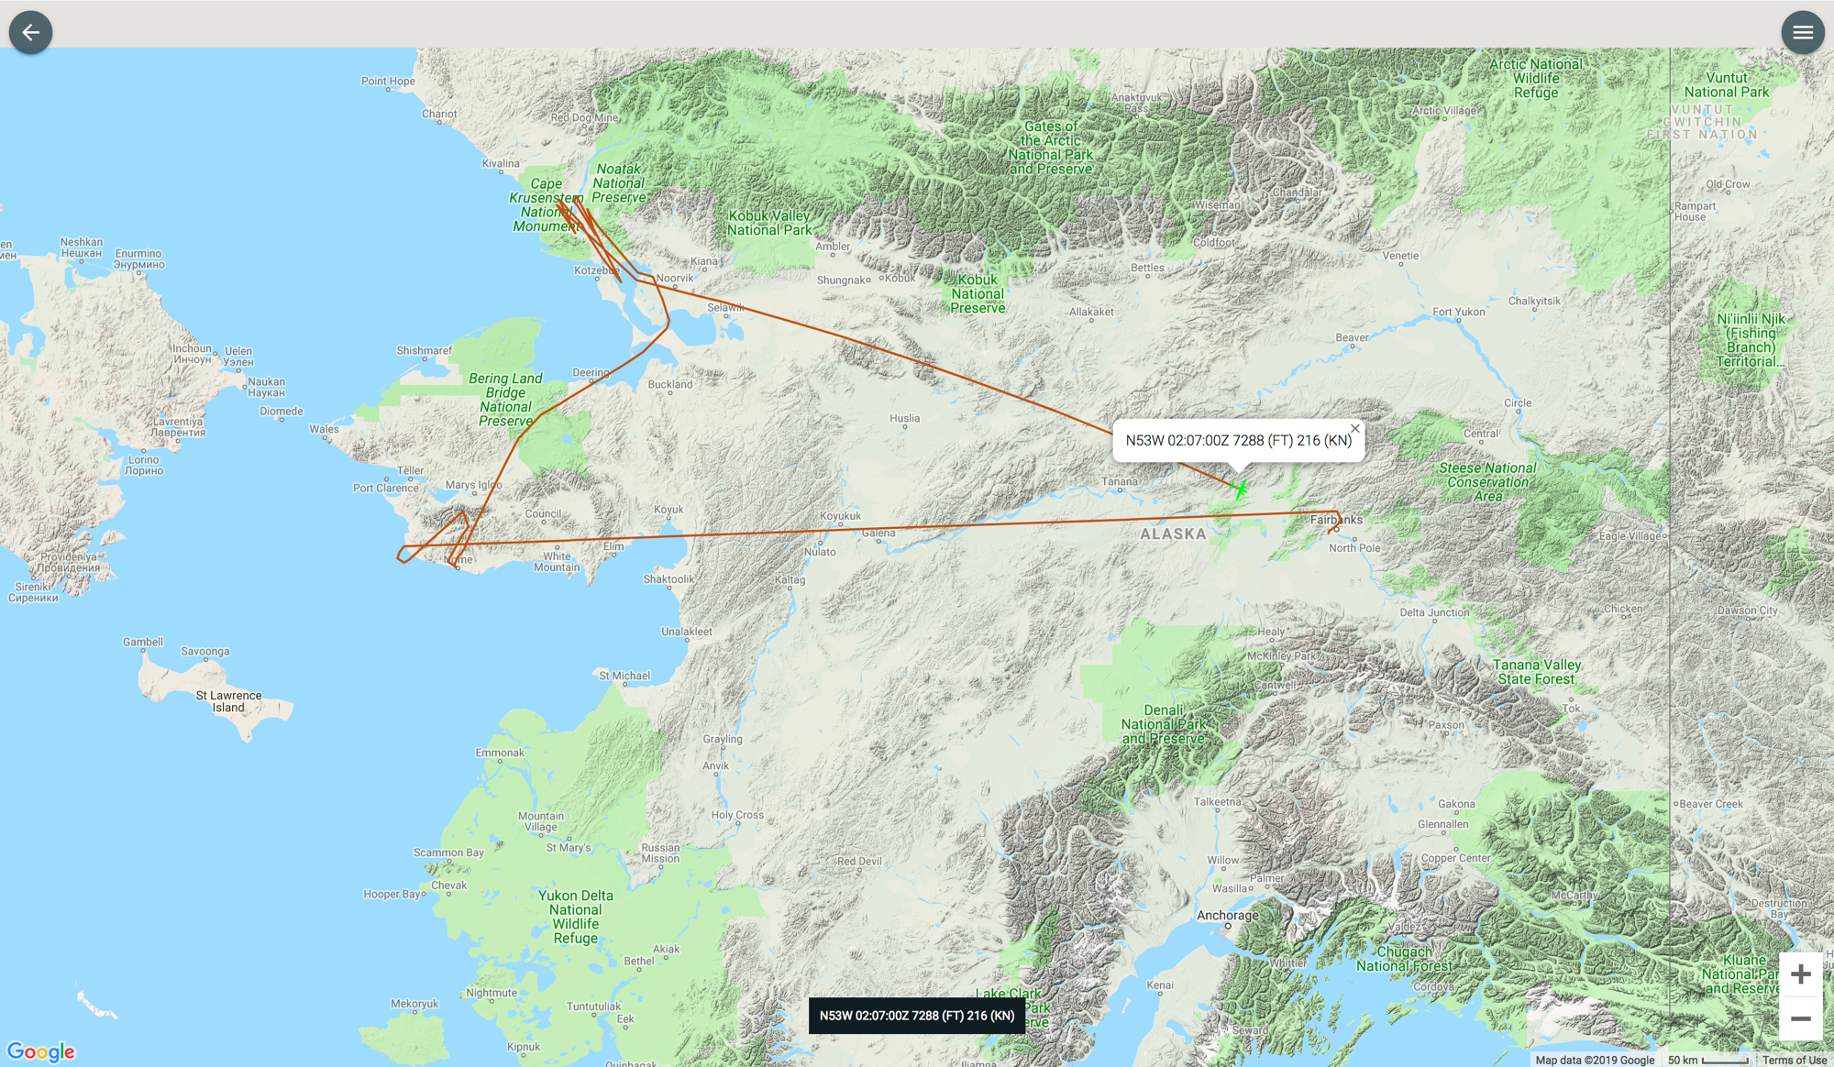
7 July 2019/DOY 188 Seward Peninsula – Noatak
Leg 2
As-Flown Lines
Leg 1

Slide 8
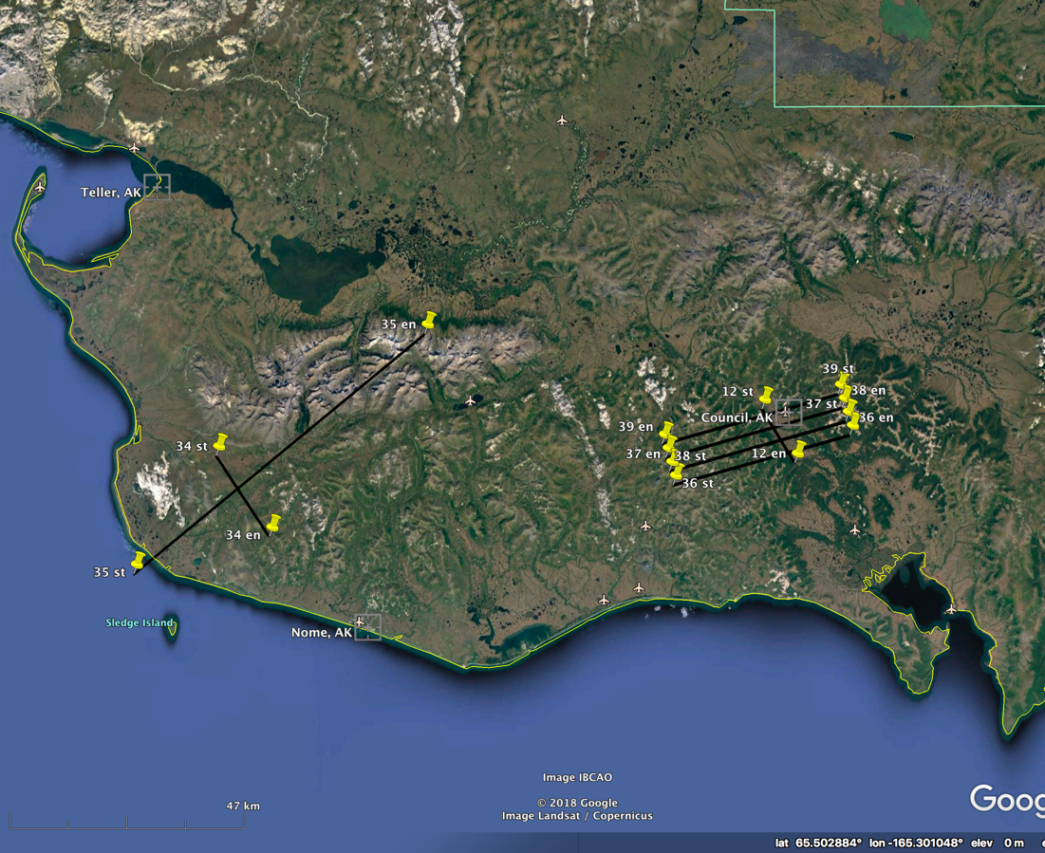
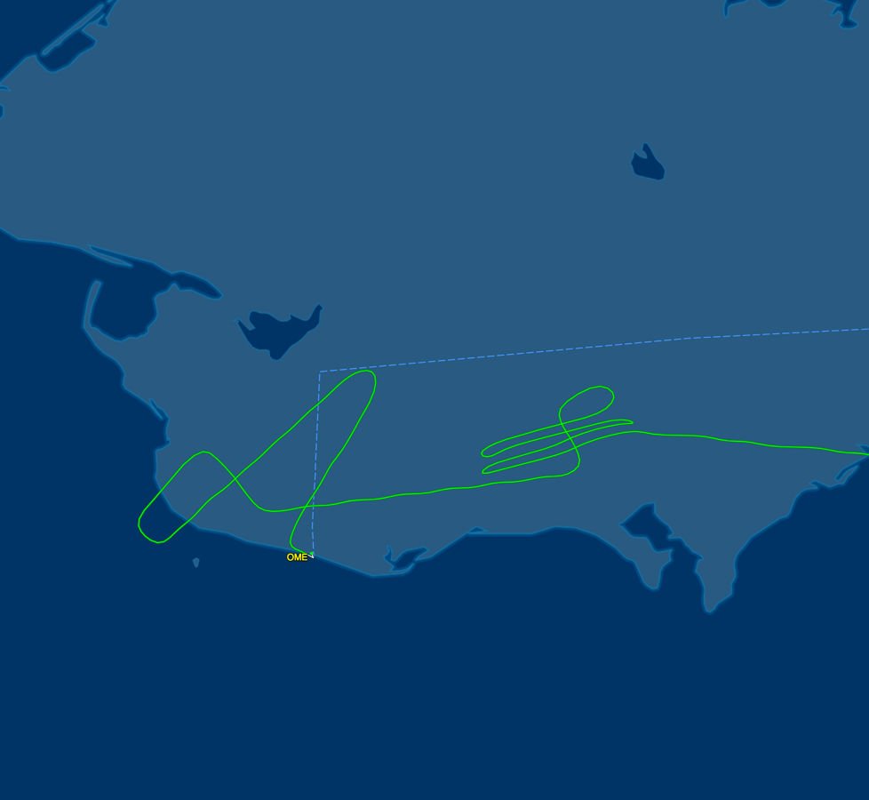
7 July 2019/DOY 188 Seward Peninsula – Noatak
Seward Peninsula
Planned Flight Lines
Seward Peninsula Area
As-Flown Lines

Slide 9
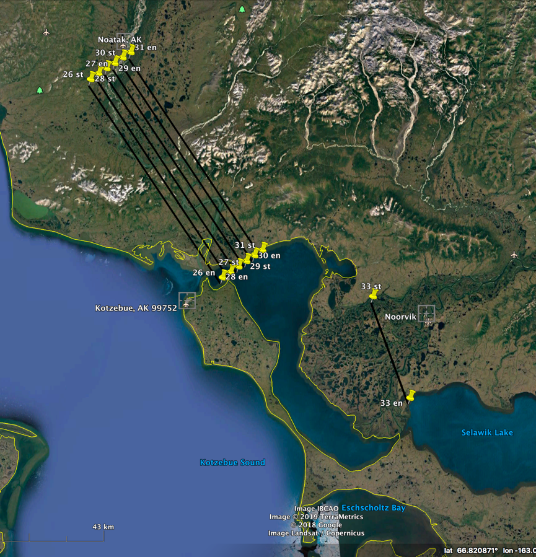
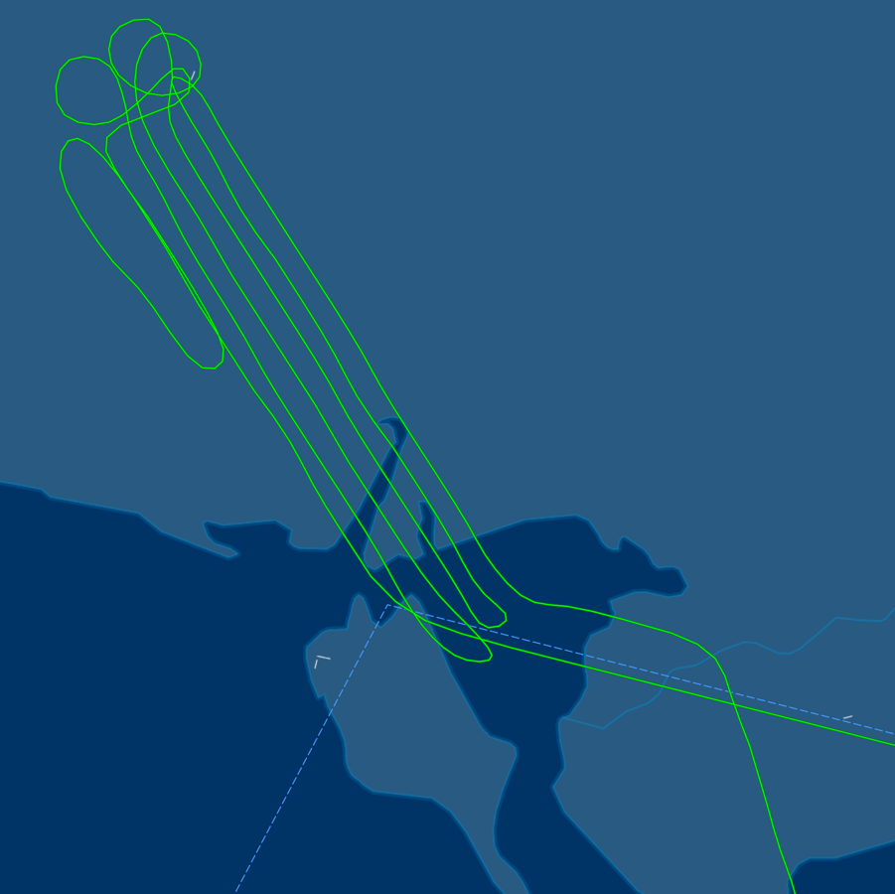
7 July 2019/DOY 188 Seward Peninsula – Noatak
Noatak Delta
Planned Flight Lines
Noatak Delta
As-Flown Lines

Slide 10
7 July 2019/DOY 188 Seward Peninsula – Noatak
AVIRIS-NG Quick-look products
https://avirisng.jpl.nasa.gov/cgi/flights.cgi?step=view_flightlog&flight_id=ang20190707t
A. Line NGEE_L001_FL188 , ang20190707t194442_geo : Council grid
B. Line NGEE_L002_FL188 , ang20190707t195230_geo : Council grid
A
B
A. Council road seen near middle of the page
B. Good image of the Council watershed
Notes:
7/19/19 Review – Flight Log: clear above, haze below
GREEN
GREEN

Slide 11
7 July 2019/DOY 188 Seward Peninsula – Noatak
AVIRIS-NG Quick-look products
https://avirisng.jpl.nasa.gov/cgi/flights.cgi?step=view_flightlog&flight_id=ang20190707t
A. Line NGEE_L003_FL188 , ang20190707t200027_geo : Council grid
B. Line NGEE_L004_FL188 , ang20190707t200750_geo : Council grid
A
B
A. Council road seen near middle of the page
B. Good image of Council and its airstrip
Notes:
7/19/19 Review – Flight Log: very light cirrus above, clear below
GREEN
GREEN

Slide 12
7 July 2019/DOY 188 Seward Peninsula – Noatak
AVIRIS-NG Quick-look products
https://avirisng.jpl.nasa.gov/cgi/flights.cgi?step=view_flightlog&flight_id=ang20190707t
A. Line AVng_347A-347Z_FL176 , ang20190707t201743_geo : CALM, Council flux tower
B. Line AVng_343A-343Z_FL179 , ang20190707t203417_geo : Teller Watershed
A
B
A. Significant greening already under way in central Seward Peninsula
B. Excellent image highlighting the rugged topography of the Teller watershed
Notes:
7/19/19 Review – Flight Log: very light cirrus above, clear below
GREEN
GREEN

Slide 13
7 July 2019/DOY 188 Seward Peninsula – Noatak
AVIRIS-NG Quick-look products
https://avirisng.jpl.nasa.gov/cgi/flights.cgi?step=view_flightlog&flight_id=ang20190707t
A. Line AVng_344A-344Z_FL184 , 204439: Teller – Kougarok transect
B. Line AVng_354A-354Z_FL175 , ang20190707t225214_geo : Noorvik area
A
Purposely left blank
B
A. In process
B. Excellent image highlighting the rugged topography of the Teller watershed
Notes:
7/19/19 Review – Flight Log: clear
GREEN
GREEN; flight log: clear above, slight haze below

Slide 14
7 July 2019/DOY 188 Seward Peninsula – Noatak
AVIRIS-NG Quick-look products
https://avirisng.jpl.nasa.gov/cgi/flights.cgi?step=view_flightlog&flight_id=ang20190707t
A. Line Kotzebue_L006_FL176 , ang20190707t230232_geo : Noatak grid
B. Line Kotzebue_L005_FL176 , ang20190707t231539_geo : Noatak grid
A
B
A. Patches of greening and unproductive land surface
B. Excellent image with bright blue Noatak River colors
Notes:
7/19/19 Review
GREEN: flight log: clear above, slight haze below
GREEN: flight log: clear

Slide 15
7 July 2019/DOY 188 Seward Peninsula – Noatak
AVIRIS-NG Quick-look products
https://avirisng.jpl.nasa.gov/cgi/flights.cgi?step=view_flightlog&flight_id=ang20190707t
A. Line Kotzebue_L004_FL176 , 232840: Noatak grid
B. Line Kotzebue_L003_FL176 , ang20190707t234959_geo: Noatak grid
A
Image in process
Purposely left blank
B
A. In process
B. Excellent image with bright blue Noatak River colors
Notes:
7/19/19 Review
YELLOW: flight log: clear but NGDCS issue at end of line
GREEN: flight log: clear

Slide 16
7 July 2019/DOY 188 Seward Peninsula – Noatak
AVIRIS-NG Quick-look products
https://avirisng.jpl.nasa.gov/cgi/flights.cgi?step=view_flightlog&flight_id=ang20190708t
A. Line Kotzebue_L002_FL176 , ang20190708t000356_geo : Noatak grid
B. Line Kotzebue_L001_FL176 , ang20190708t003752_geo : Noatak grid
A
B
A. Excellent image
B. Excellent image; some processing errors at very end of swath
Notes:
7/19/19 Review
GREEN: flight log: clear but NGDCS issue at end of line
YELLOW for coverage; quality = GREEN; NGCDS issue at end; aborted

Slide 17
7 July 2019/DOY 188 Seward Peninsula – Noatak
AVIRIS-NG Quick-look products
https://avirisng.jpl.nasa.gov/cgi/flights.cgi?step=view_flightlog&flight_id=ang20190708t
A. Line Kotzebue_L001_FL176 , ang20190708t002535_geo : Noatak grid
A
B
A. Line aborted – computer issue
Notes:
7/19/19 Review
2nd attempt; YELLOW for coverage; quality = GREEN; NGCDS issue; aborted

Slide 18
Backup

Slide 19
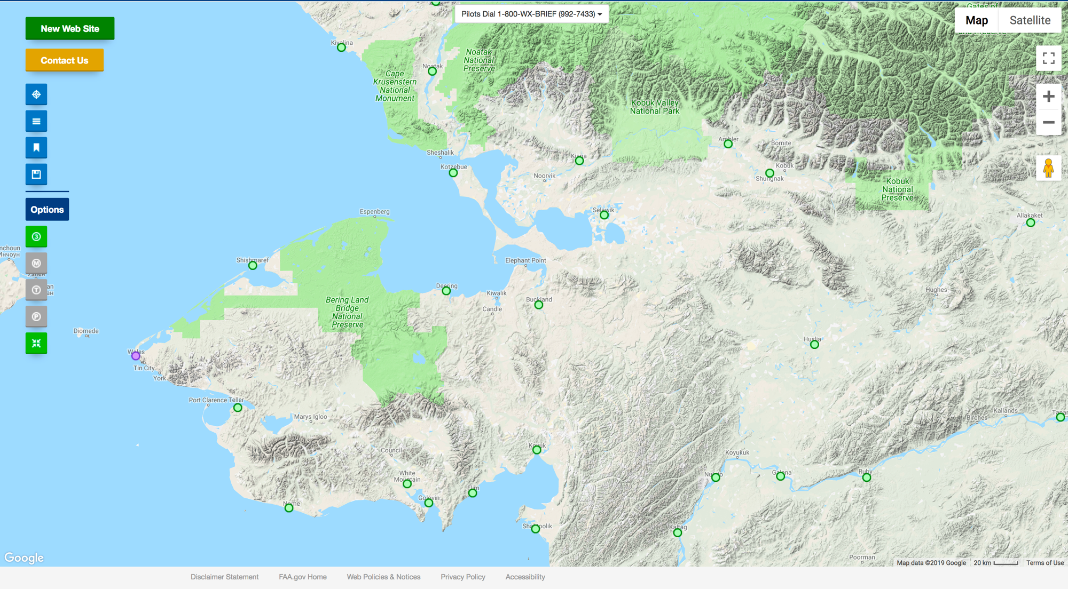
FAA Camera Locations

Slide 20
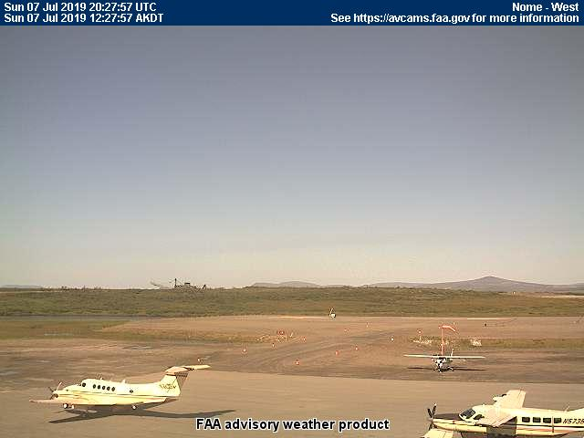
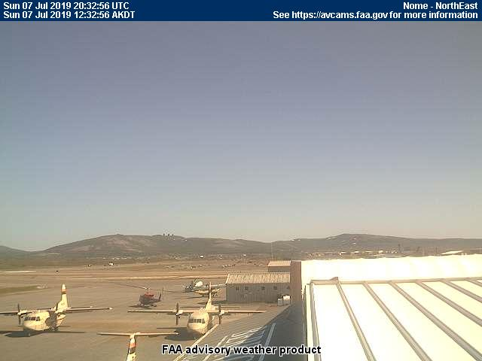
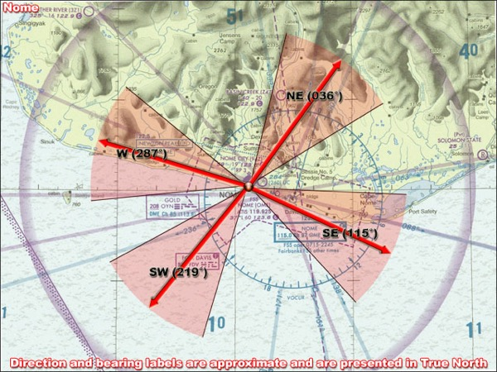
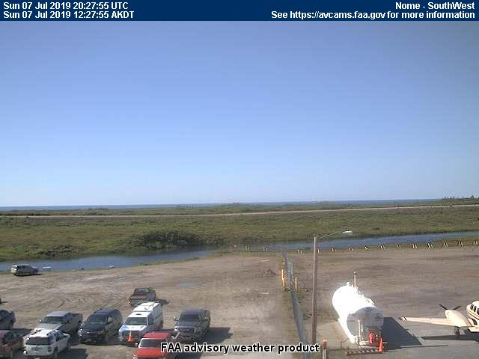
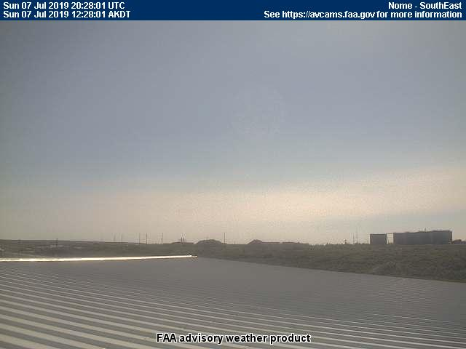
7 July 2019/DOY 188 Seward Peninsula – Noatak
Nome (POME) – 1227 AKDT/2027 UTC
West
Northeast
Southwest
Southeast

Slide 21
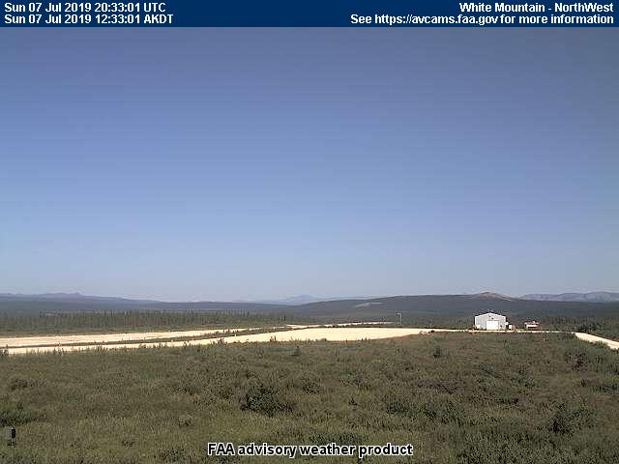
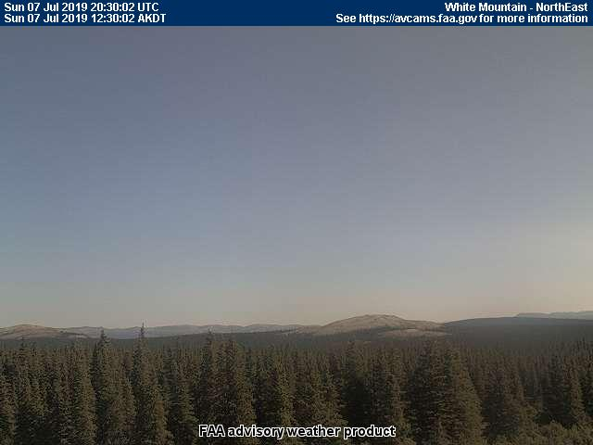
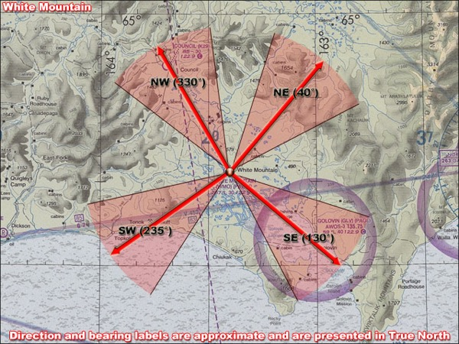
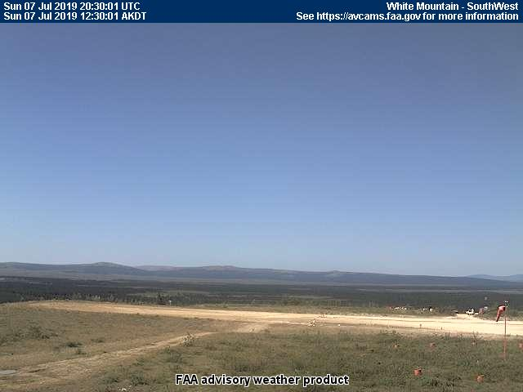
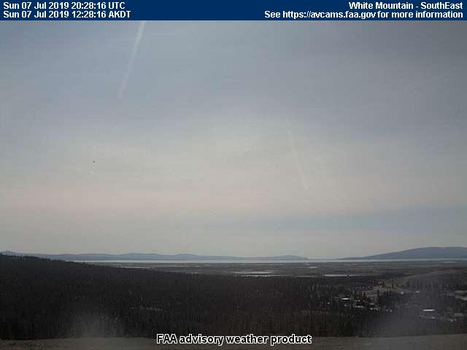
7 July 2019/DOY 188 Seward Peninsula – Noatak
White Mountain – 1233 AKDT/2033 UTC
Northwest
Northeast
Southwest
Southeast

Slide 22
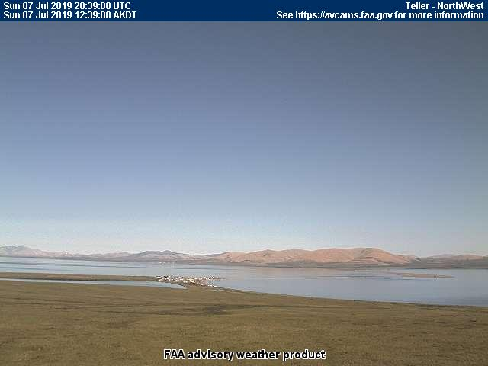
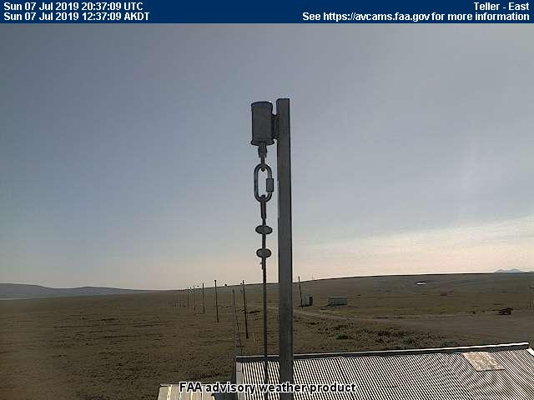
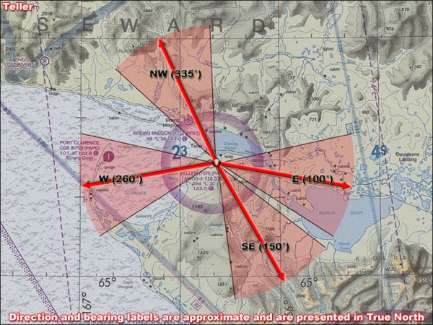
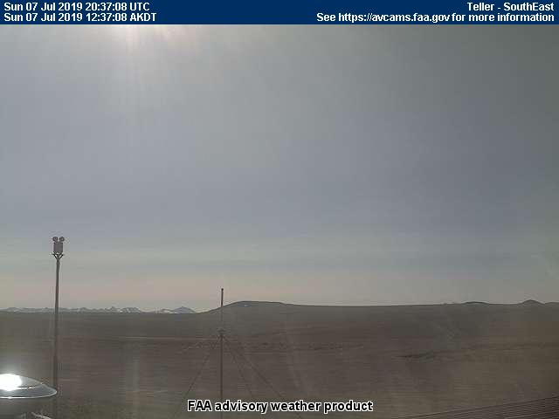
7 July 2019/DOY 188 Seward Peninsula – Noatak
Teller (TER) – 1239 AKDT/2039 UTC
Northwest
East
West
Southeast

Slide 23
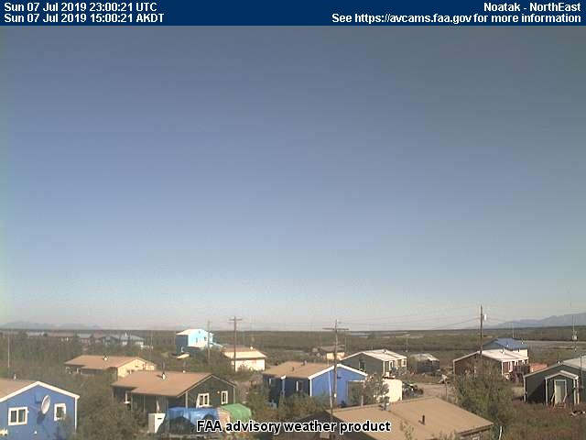
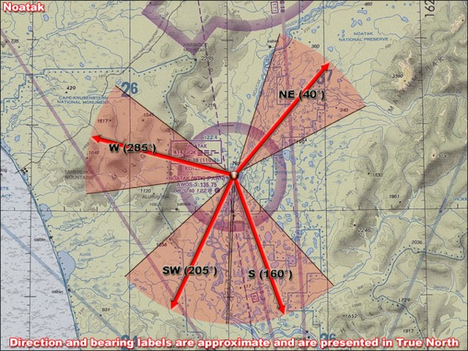
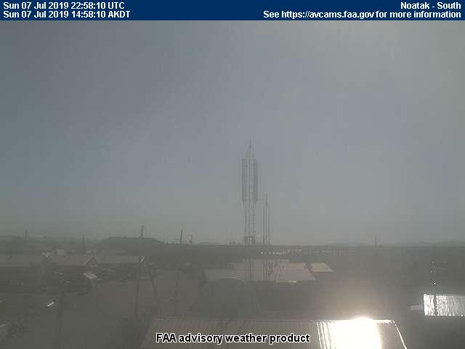
7 July 2019/DOY 188 Seward Peninsula – Noatak
Noatak (WTK) – 1458 AKDT/2258 UTC
West
Northeast
Southwest
South

Slide 24
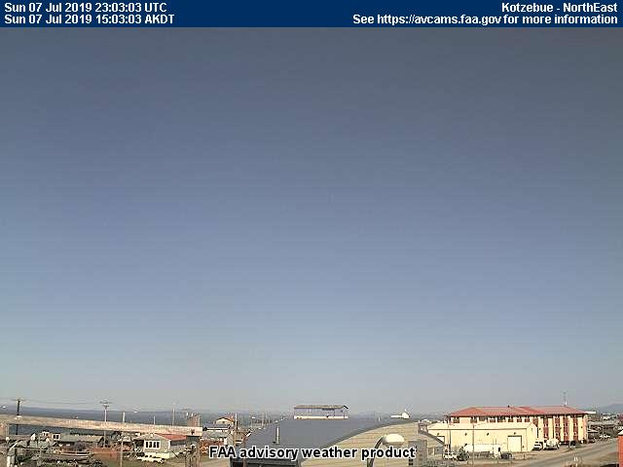
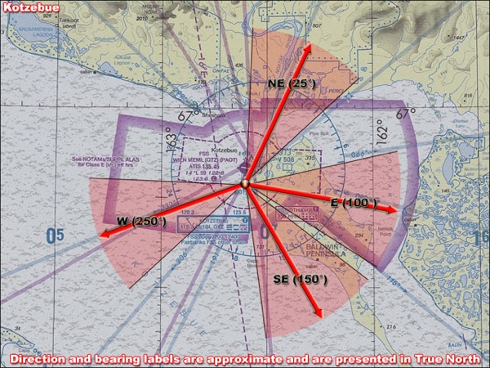
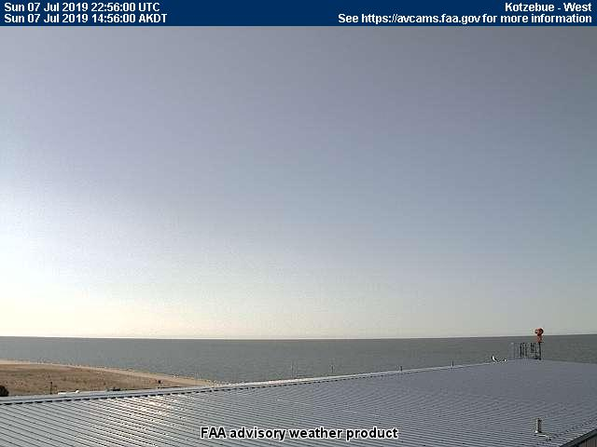
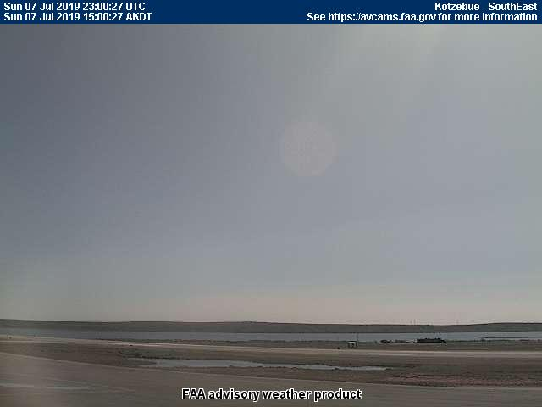
7 July 2019/DOY 188 Seward Peninsula – Noatak
Kotzebue (POTZ) – 1330 AKDT/2130 UTC
Northeast
East
West
Southeast

Slide 25
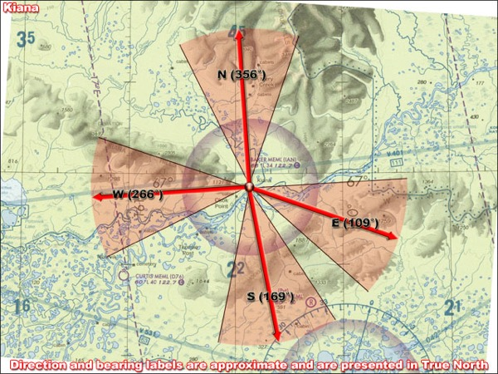
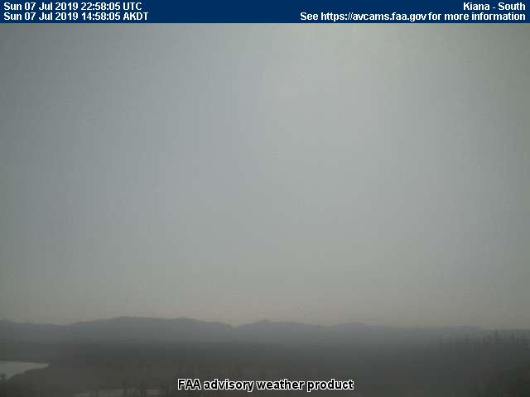
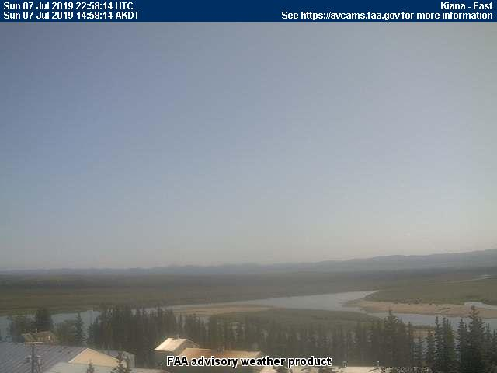
7 July 2019/DOY 188 Seward Peninsula – Noatak
Kiana (IAN) – 1458 AKDT/2258 UTC
West
North
South
East

